Slide 1
Visual Effects Presentation
Name: Abdelrady Elagamy Abdelrady.
Class: 2.
IT Departement.
Under supervision of: Dr. Khaled f. Hussien

Slide 2
Brief Description
This demo enables you to apply different visual effects to a video stream. The demo uses the parameters you specify in the Effects block dialog box to alter the appearance of the video frames.
Your choices are Relief, Sharpen, Oil painting, Emboss, Blur, or Spread.

Slide 3
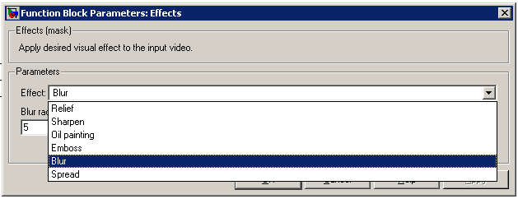
Effects Mask

Slide 4
Brief Desc.
The Relief, Sharpen, Emboss, and Blur effects demonstrate the 2-D filtering capabilities of the Video and Image Processing Blockset
The Oil painting and Spread effects use the Block Processing block to perform operations on submatrices of the input to achieve the specified visual effect.

Slide 5
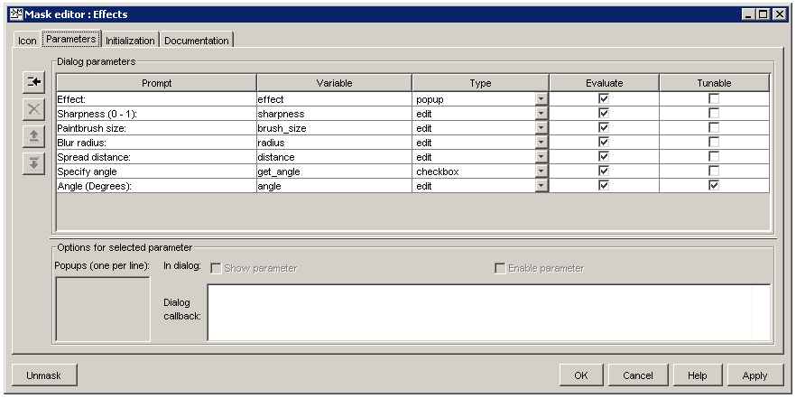
Effects Mask Parameters

Slide 6
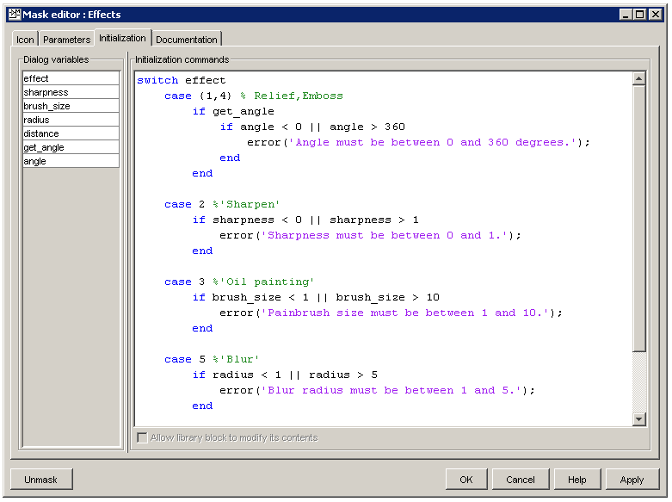
Parameter Initialization

Slide 7
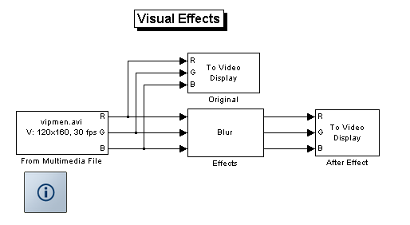
Effects Model
View Original Video
Source Video
Show Video after Effect
Assign Specific Effect

Slide 8
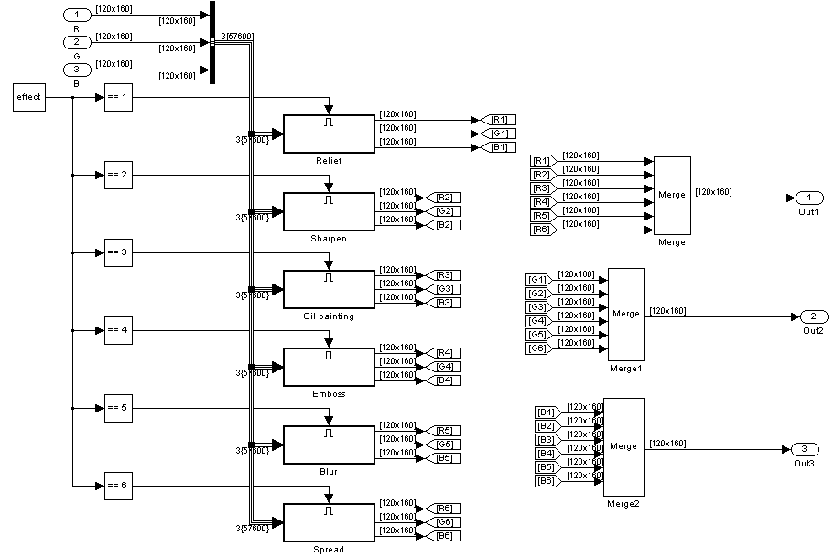
Video Input
Effect Output
Merge all red channels
Effect ID

Slide 9
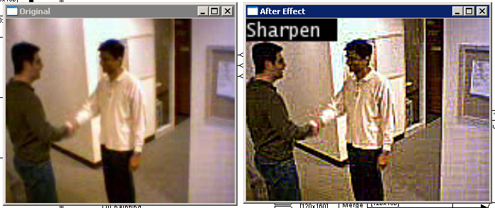
Sharpen Effect

Slide 10
Sharpen Image Effect
To sharpen a color image, you need to make the luma intensity transitions more acute(حاد | واضح), while preserving the color information of the image. To do this, you need to apply a highpass filter to the luma portion of the image only.
So you can use 2D-Filter & passes image elements & define the Effect by ….

Slide 11
What to use
You can use the fspecial('unsharp') command creates two-dimensional highpass filter coefficients suitable for correlation. This highpass filter sharpens the image by removing the low frequency noise in it.
Or if you know sharpen algorithm you can produce matrix coefficients by your self & passes them to 2D-Filter

Slide 12
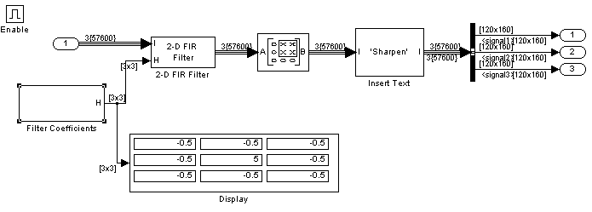
Sharpen Effect
This matrix is relevant to input
Sharpness=0.5

Slide 13
Sharpen Effect
This matrix is relevant to input
Sharpness=0.5

Slide 14

Enable Subsystem
An enabled subsystem executes while the input received at the Enable port is greater than zero.

Slide 15
Sharpen Effect
This matrix is relevant to input
Sharpness=0.5

Slide 16

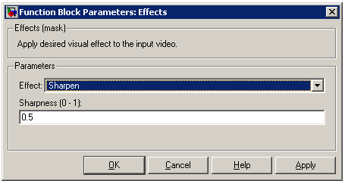
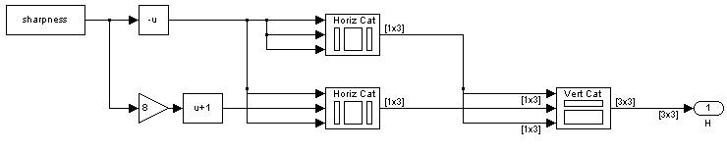
Filter Coefficients
Produce 3X3 matrix coefficients for 2D-filter to apply sharpen effect

Slide 17
Sharpen Effect
This matrix is relevant to input
Sharpness=0.5

Slide 18

2D-Filter
The 2-D FIR Filter block filters the input matrix I using the coefficient matrix H
As (I) is image input
And H is matrix coefficients

Slide 19
Sharpen Effect
This matrix is relevant to input
Sharpness=0.5

Slide 20


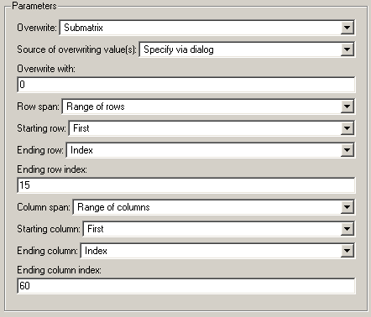
Overwrite Values
Overwrite submatrix or subdiagonal of input by any value, Here we will draw black rectangle in the upper left corner of image

Slide 21
Sharpen Effect
This matrix is relevant to input
Sharpness=0.5

Slide 22

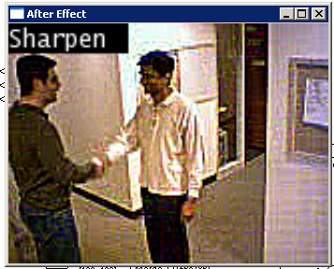
Insert text
Used to draw text on image or video stream

Slide 23
Blur Effect
The only difference between it & the Sharpen effect is the matrix coefficients.
So to blur an image you have to creates two-dimensional Gaussian lowpass filter coefficients. This lowpass filter blurs the image by removing the high frequency noise in it.

Slide 24
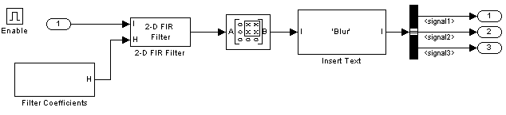
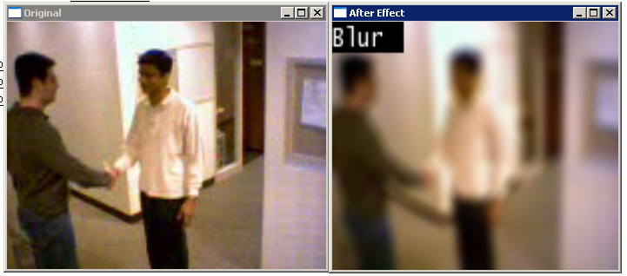
Blur Effect

Slide 25
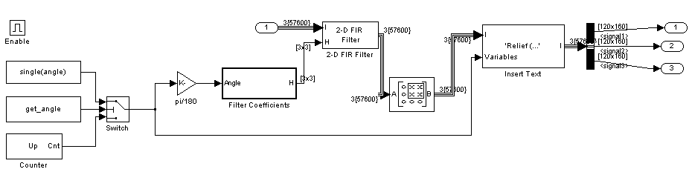
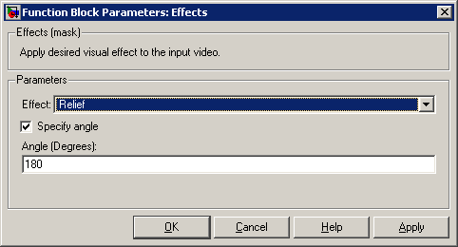
Relief Effect

Slide 26

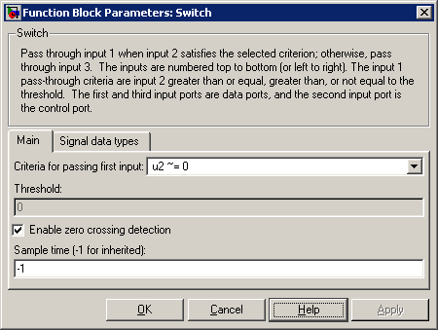
Switch

Slide 27

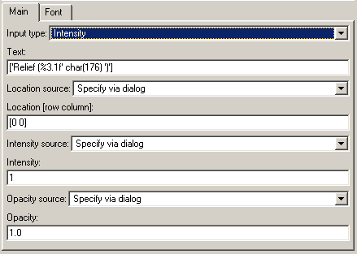
Insert text
Char(176) mean (°) degree sign

Slide 28
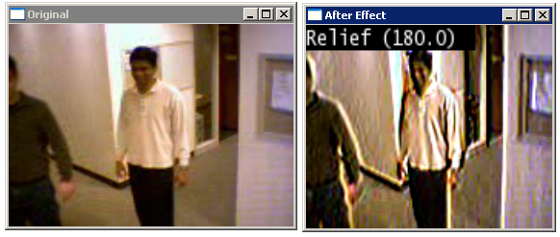
Relief Effect
Relief mean (وضوح المعالم)

Slide 29
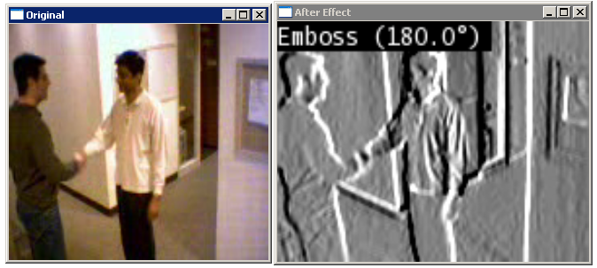
Emboss Effect

Slide 30
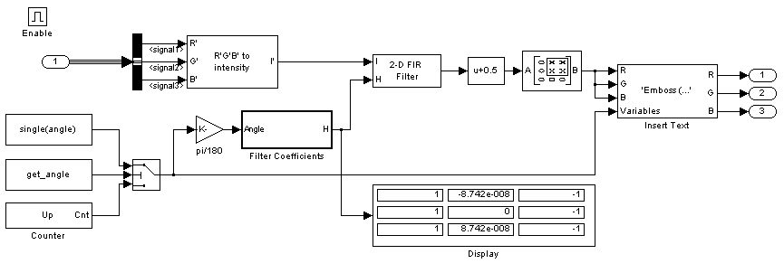
What is the difference
It deal with intensity images
Output matrix if input is Angle=180

Slide 31
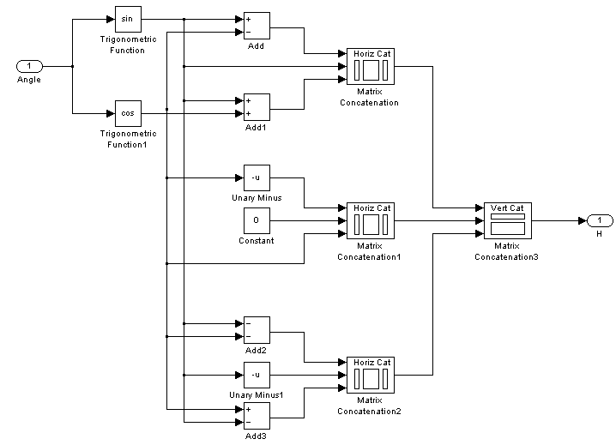
What is the difference
Filter coefficient

Slide 32
Oil Painting Effect
It deal with the luma intensity transitions, while preserving the color information of the image
This effect as I understand, uses block processing to deal with image stream as submatrix [3x3] & try to find the most common Luma (Y Element) from submatix histogram , & then it assign this luma to all submatrix values.

Slide 33
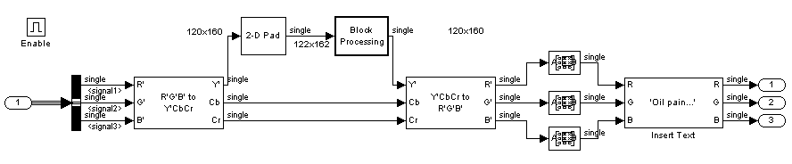
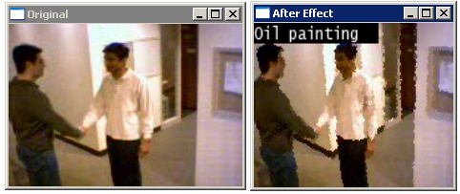
Oil Painting Effect

Slide 34
Oil Painting Effect

Slide 35
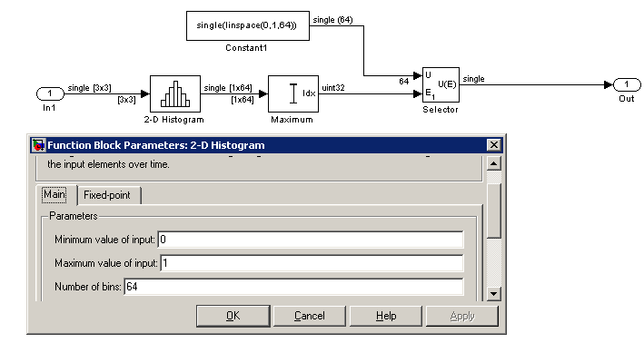
Block Processing Subsystem

Slide 36
Block Processing Subsystem

Slide 37
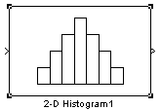

2D Histogram
Generate histogram of each input matrix
Basic Operation
if your input is and you set the block parameters as follows:
Maximum value of input = 4
Number of bins = 5
The block output is: [3 3 3 0 0].

Slide 38
Block Processing Subsystem

Slide 39
linspace
Generate linearly spaced vectors
Description
y = linspace(a,b) generates a row vector y of 100 points linearly spaced between and including a and b.
y = linspace(a,b,n) generates a row vector y of n points linearly spaced between and including a and b.

Slide 40
Block Processing Subsystem

Slide 41

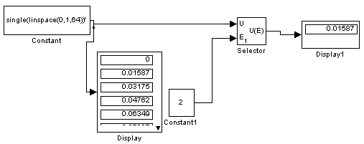
Selector
Select input elements from a vector or matrix signal.
U is vector or matrix, E is Index.

Slide 42
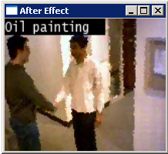
Oil Painting Effect
Overwrite top left corner of image with black color(0)
& then insert text (oil painting) on it

Slide 43

The End

Slide 44
References
Matlab Help
Sharpening and Blurring an Image :: Analysis and Enhancement (Video and Image Processing Blockset) In Matlab Help (Content Tap)

